Slide 1
Organizational Transformation in Equity
Marie-Elizabeth Ramas, MD, FAAFP
VMS Annual Meeting
November 7, 2020

Slide 2
No Disclosures

Slide 3
OBJECTIVES
Identify the difference between health disparities, inequities, and equity
Describe one way we contribute to perpetuating health disparities and inequities
List at least one medical tool that falsely uses race as a scientific measure
Name at least one upstream contributor or determinant of health
Describe our role in improving data capacity for equity
List at least 3 equity-promoting strategies we can implement at the individual, organization or systems level

Slide 4
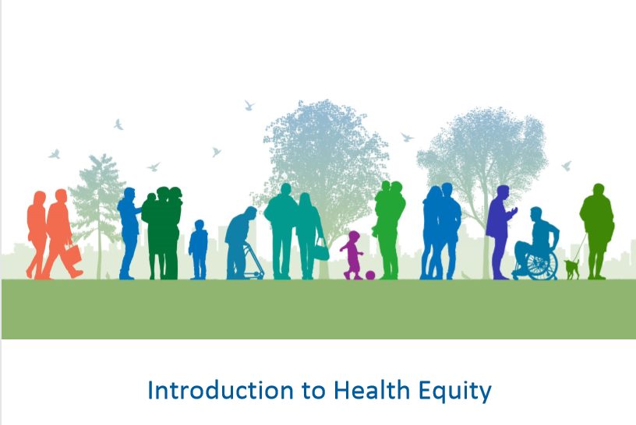
Health Equity: Why We Care
Notes:
We are going to talk about health equity. We are going to talk about it in two parts. First, we will focus on painting a picture of why health equity matters to us here in the Granite State. In our next presentation, the next part of the discussion will highlight what we can do about addressing inequities.
While matters of health equity span beyond the boundaries of racial inequity, given the diverse origins of our medical developments in American history and the intimate connection of race within our American context, we often highlight racial disparities. While you will see various illustrations regarding race today, keep in mind that we can expand these conceptions to age, geographic location, socioeconomic status, gender, or other characteristics.

Slide 5
DR. CHANIECE WALLACE
Notes:
Dr. Chaniece Wallace, a pediatric chief resident in Indiana University School of Medicine, died after developing pre-eclampsia the day her daughter was delivered prematurely via C-section. 35wk baby girl, Charlotte, 4lbs 5oz, 16in
Wallace developed symptoms of preeclampsia on October 20, the same day her daughter was born. Over the next two days, she underwent surgery and experienced a ruptured liver, high blood pressure, and poorly functioning kidneys
BLACK rates of pre-eclampsia and eclampsia are about 60% higher than white women, and who are more likely to experience poor outcomes from the condition, one 2017 report out of the US Agency for Healthcare Research and Quality found

Slide 6
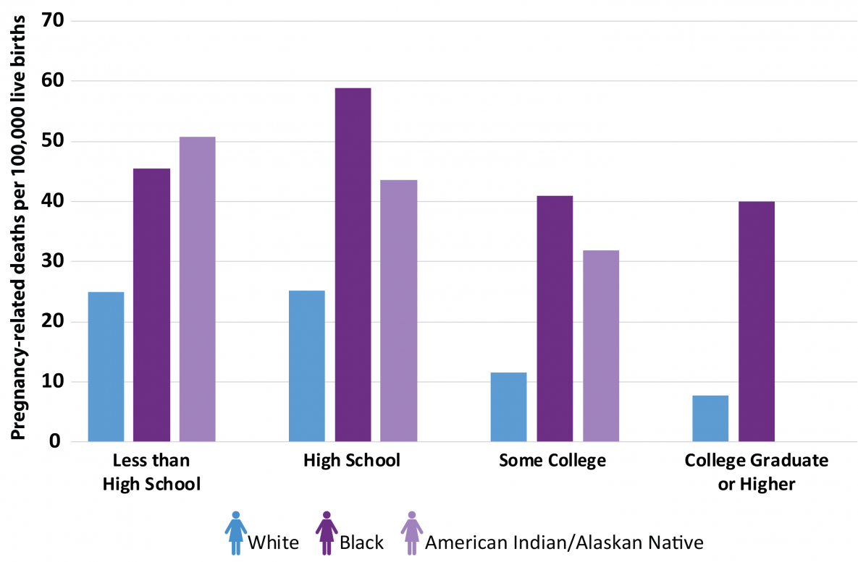
NO DISCLOSURES
https://www.cdc.gov/reproductivehealth/maternal-mortality/disparities-pregnancy-related-deaths/infographic.html
Notes:
The PRMR for black women with at least a college degree was 5 times as high as white women with a similar education
We generally think that there is a protective social gradient in health outcomes, and we can see that in white women– In otherwords,
And in fact, even being a college graduate is still worse than a white woman college
THERE IS SOMETHING ABOUT BEING BLACK IN AMERICA THAT CAUSES RISK

Slide 7
HEALTH DISPARITIES
Health Disparities are the metrics we use to measure progress toward achieving health equity
- Paula Braveman and Laura Gottlieb
Notes:
Health disparities are differences or observations used to measure progress toward achieving

Slide 8
INEQUITY
"…systematic differences in health between different socioeconomic groups within a society. As they are socially produced, they are potentially avoidable and are widely considered unacceptable in a civilised society” – Margaret Whitehead, 2007
Notes:
READ THE SLIDE
- SOCIALLY PRODUCED, POTENTIALLY AVOIDABLE, UNJUST AND UNFAIR
Equity is the absence of avoidable, unfair, or remediable differences among groups of people, whether those groups are defined socially, economically, demographically or geographically or by other means of stratification

Slide 9
HEALTH EQUITY
Everyone has a fair and just opportunity to be as healthy as possible
Braveman P, Arkin E, Orleans T, Proctor D, and Plough A. What Is Health Equity? And What Difference Does a Definition Make?
Princeton, NJ: Robert Wood Johnson Foundation, 2017 https://www.rwjf.org/en/library/research/2017/05/what-is-health-equity-.html

Slide 10
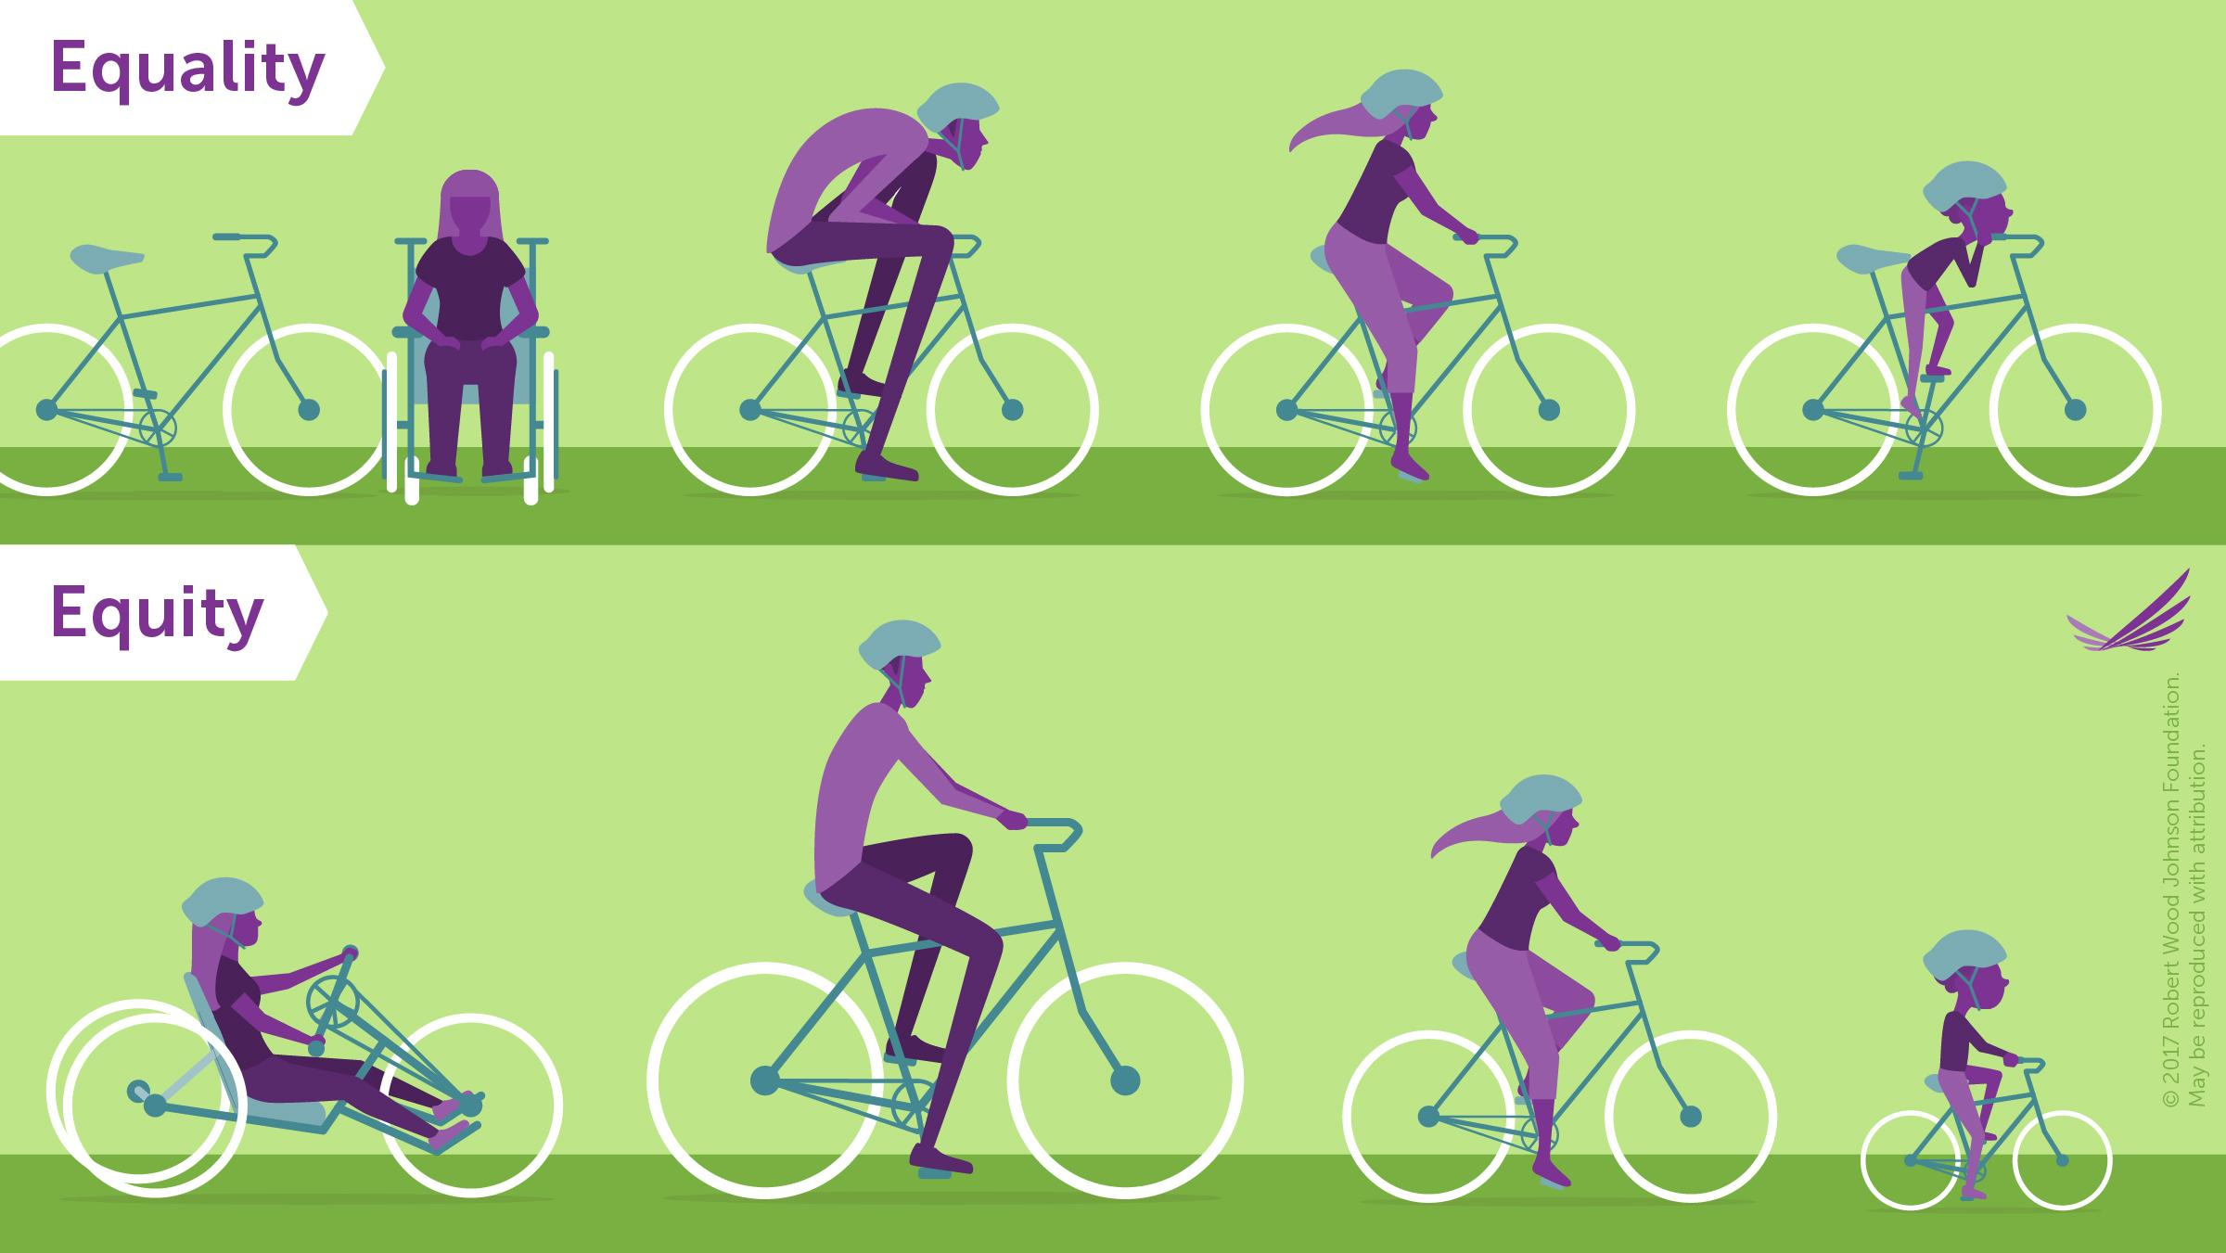
Everyone gets the same
Everyone gets what they need
Notes:
EQUITY MEANS THAT EVERYONE HAS EQUALITY OF OPPORTUNITY
Some people say that “This is America” and focus on fairness. On the bottom, everyone gets what they need to have the same opportunity. In this case, the bicycle.
EXPLAIN THE SLIDE
So everyone here is a health provider. How do you hear about health equity within your work? I’m sure you have heard people mention implicit bias. So let’s take a brief look into that….

Slide 11
IMPLICIT BIAS
“the attitudes or stereotypes that affect our understanding, actions, and decisions in an unconscious manner”
http://kirwaninstitute.osu.edu/research/understanding-implicit-bias/
Notes:
Implicit bias is normal, unconscious and everyone has it. This is a normal process helps us make sense of the world around us.
Implicit biases are pervasive. Everyone possesses them, even people with avowed commitments to impartiality such as judges.
Implicit and explicit biases are related but distinct mental constructs. They are not mutually exclusive and may even reinforce each other.
The implicit associations we hold do not necessarily align with our declared beliefs or even reflect stances we would explicitly endorse.
We generally tend to hold implicit biases that favor our own ingroup, though research has shown that we can still hold implicit biases against our ingroup.
Implicit biases are malleable. Our brains are incredibly complex, and the implicit associations that we have formed can be gradually unlearned through a variety of debiasing techniques.

Slide 12
IMPLICIT BIAS AND HEALTHCARE
Notes:
So let’s take a look at how explicit bias is baked into our practices in medicine
Clearly bias has impact and let’s recognize that in addition to implicit bias, there is racism

Slide 13
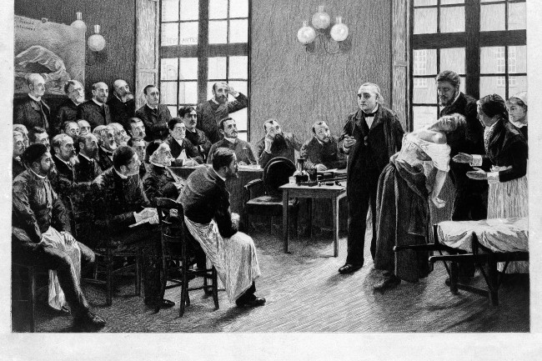
CONFRONTING OUR PAST TO CHANGE OUR FUTURE
Notes:
I’m sure that many of you have seen the recent headlines of the historical exploitation of blacks throughout our medical history.

Slide 14
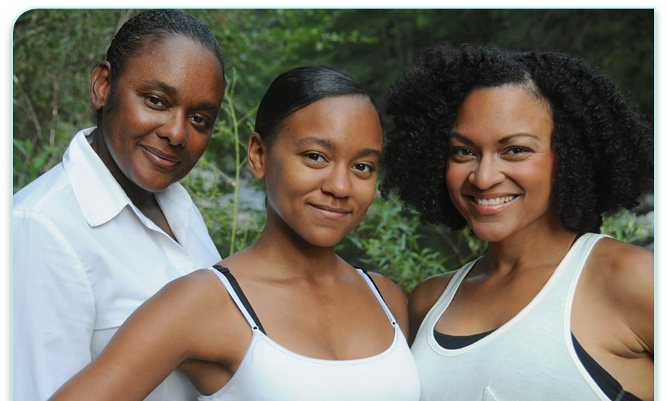
Bias is Baked into the Practice of Medicine
GFR
VBAC
JNC 8 Hypertension Guidelines
PFT
Treatment of Pain
HTN treatment
FRAX
https://www.thelancet.com/journals/lancet/article/PIIS0140-6736(20)32076-6/fulltext
https://www.whijournal.com/article/S1049-3867(19)30098-2/pdf
Notes:
But the effects of these teachings continue to cause undo harm and death to black and brown patients
Although the concept of race is well understood to have no scientific basis, but rather is loosely defined and changes depending on cultural and societal norms, we still use race as a proxy to science
1. Black patients are presumed to have greater muscle mass than patients of other races and estimates of their renal function are accordingly adjusted, and thus are at risk of delayed dialysis and transplant qualification
2. JNC-8 criteria have different pathways based on race: ACE-inhibitor use associated with higher risk of stroke and poorer control of blood pressure in Black patients than in patients of other races
2. A 2016 study showed that medical students and residents who believed that Black and White people are biologically different rated the pain experienced by Black patients as lower than that experienced by White patients, and they recommended inappropriate treatments.
3. On the basis of the understanding that Asian patients have higher visceral body fat than do people of other races, they are considered to be at risk for diabetes at lower body-mass indices
4. The VBAC calculator has two race-based correction factors, one for African American women and another for Hispanic
women. These correction factors “subtract” from the overall likelihood of successful VBAC, so that women identified as African American or Hispanic are systematically assigned a lower chance of successful VBAC than white women. Many factors identified in this studydrace, insurance type, and marital status likely relate to women’s outcomes through associated social advantage or disadvantage. Yet among these factors, only race was incorporated into the final predictive model

Slide 15
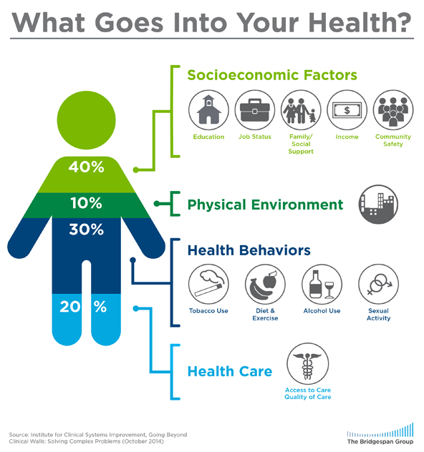
Notes:
Remember that equity is not just about race and our wellness is not simply the diagnoses that we treat in the office. Read slide

Slide 17
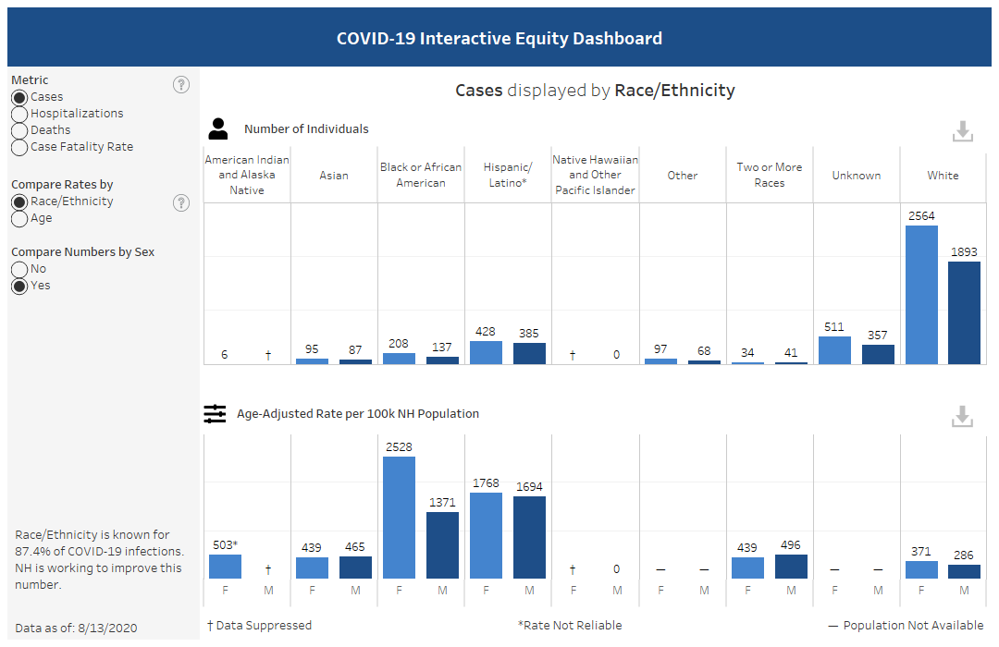
COVID AND EQUITY IN THE GRANITE STATE
Black women 6x more than white women
Black women 8x more than white men
https://www.nhpr.org/post/covid-19-data-shows-racial-disparities-nh-cases
https://www.governor.nh.gov/sites/g/files/ehbemt336/files/documents/equity-response-team.pdf
Notes:
Latinos account for about 7 percent of those cases; and African Americans for 5.6 percent. As a percentage of the population, New Hampshire is 3.9 percent Latino and 1.4 percent black.
BLACK AND LATINO RESIDENTS ARE MORE LIKELY TO BE ESSENTIAL WORKERS
This is to say that data matters, and getting accurate information based on well-defined definitions matter. Without data, we get no funding and we have limited ability to identify gaps- This was also the case in NH where Race and ethnicity is known for about 79 percent of cases in New Hampshire.

Slide 18
Recognizing Implicit Bias
Offset the influence of implicit bias
Common Identity Formation
Perspective Taking
Empathy
Consider the opposite
Counter stereotypical exemplars
https://kirwaninstitute.osu.edu/implicit-bias-training
Notes:
Quinn Capers IV, MD, Interventional cardiologist and Vice Dean at OSU College of Medicine
Increase representation by training more women and BIPOC
2009-2019 increased application from 4000 to 8000 (more women, BIPOC)

Slide 19
AAFP EveryONE Project
To promote awareness of implicit bias among all members of the health care team
To provide resources for moderating the negative effects of implicit bias on patient care
Implicit Association Test
https://implicit.harvard.edu/implicit/education.html
https://www.aafp.org/news/practice-professional-issues/20200115implicitbias.html
Notes:
AAFP Office of Diversity and Health Equity launched the EveryOne Project in January 2020
Here an entire curriculum on Implicit Bias was created to both learn and teach other clinicians about implicit bias and mitigating factors. I have placed the link to the Implicit Association test, introduced by Harvard, which demonstrates proclivity in several areas ranging from race, ethnicity, sexual orientation, age to even BMI. As a reminder, one of the reasons that recognition of implicit bias training and implementation of mitigating factors have proven so fruitful is that we can change and become more aware of our propencities and thus potentially change behavior.
I strongly encourage leaders to under such training and perform these evaluations to help provide context to the unintended consequences of bias left unchecked.

Slide 20
Creating a Culture of Equity: Organizational
Leadership Buy-In:
- reduce costs- reduce readmissions and adverse outcomes
- improved patient outcomes: Diversity Improves Health Outcomes Oakland
- higher financial returns (Mckinsey)
- embrace discomfort
https://www.mckinsey.com/business-functions/organization/our-insights/why-diversity-matters
https://www.pnas.org/content/117/35/21194
Notes:
And this leads to creating a case for approaching organizational policies, structure and environment with an emphasis on equity. We’ve seen earlier in the presentation that unchecked bias costs the US BILLIONS of DOLLARS every year. We also know that more diverse workforce and leadership leads to better patient outcomes and jobs satisfaction. So while having these difficult conversations will cause discomfort, I cannot stress how crucial it is to address inequities in all spheres, so as to benefit everyone.

Slide 21
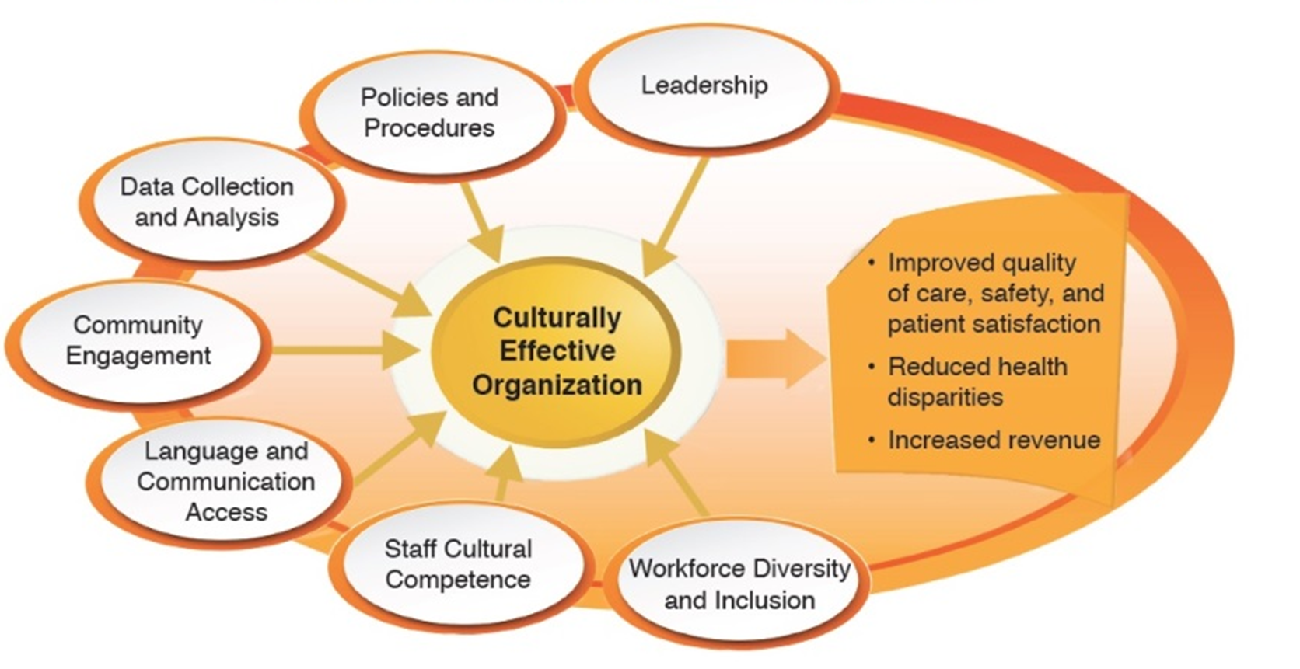
Creating a Culture of Equity: Individual
The Culturally Effective Organizations Framework
https://nhcancerplan.org/images/Conference2018/HEP_CEOrgs_FW_Toolkit.pdf
Notes:
Breaking down equity into bits in pieces helps us to operationalize the process in a more organized way.
This requires investment on multiple levels, but the result is Improve quality of care, reduce disparities and increase revenue to maintain sustainability.

Slide 22
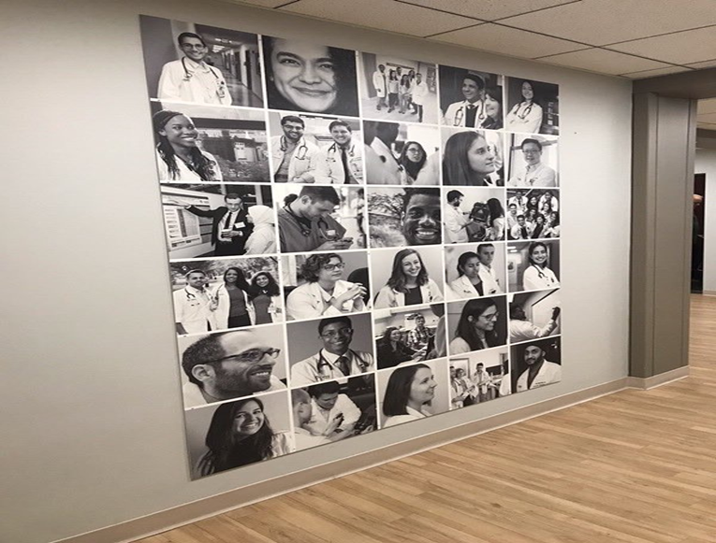
Educate faculty/staff/trainees on implicit bias
Hospital equity walk
Diversity of upper management and executives, tenured faculty, deans
Reassess hiring practices
Increase paid work with black and brown owned businesses- ex: NH Endowment for Health
Notes:
What are some low

Slide 23
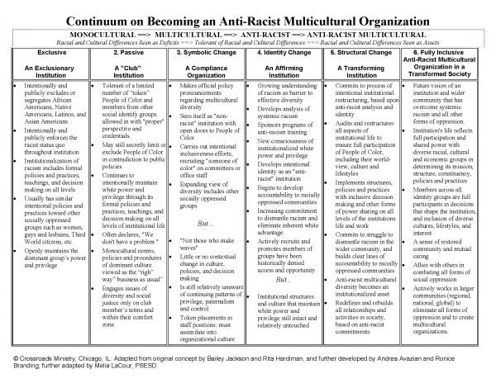

Slide 24
NH Medical Society Health Equity Advisory Council
Our Health Equity Advisory Council has met a number of times now over the past couple of months to identify and apply for grant funding that may help support some specific physician education initiatives. Regardless, we’ll continue to work to identify ways to contribute to the discussion and educate ourselves and our colleagues about issues of racial inequities in health
Dr. John Klunk, NHMS President
https://www.nhafp.org/docs/NHAFP%20Statement%20racism%202020.pdf
https://www.nhms.org/nhms-blog/nhms-health-equity-advisory-council

Slide 25
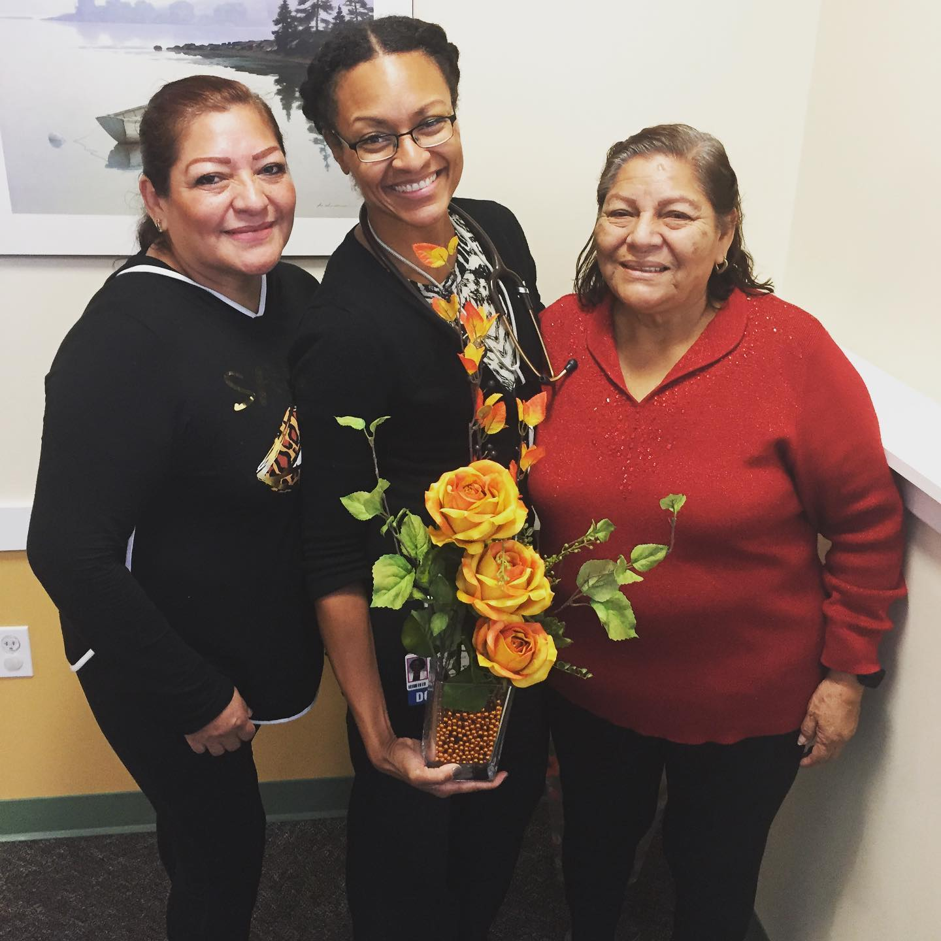
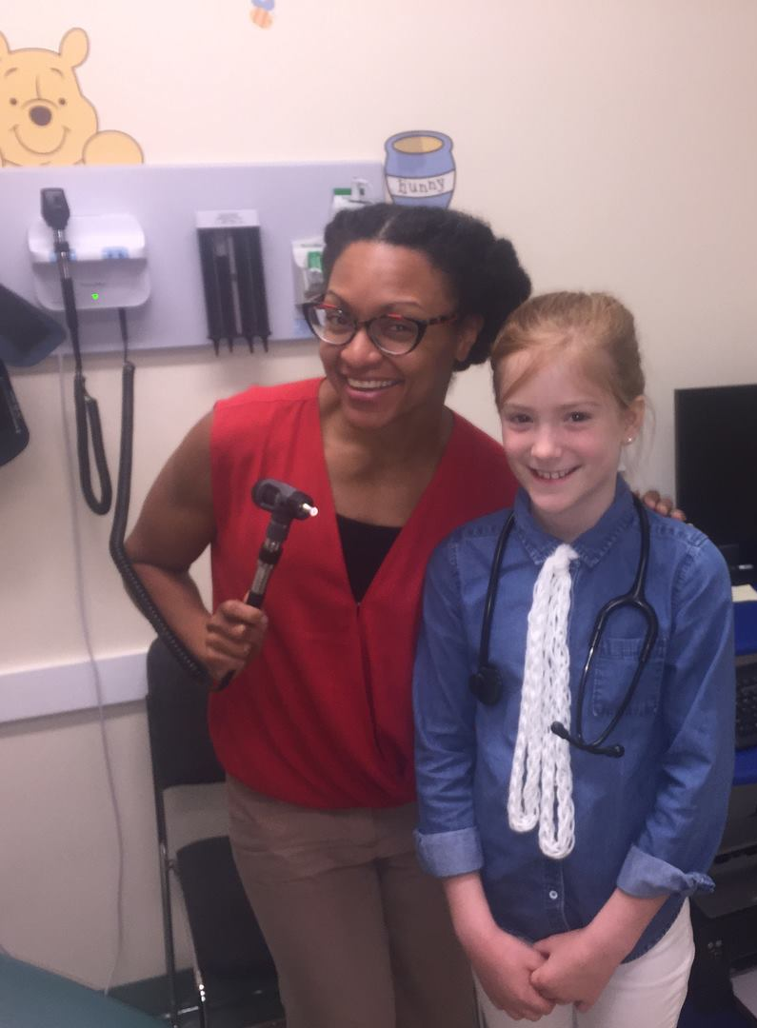
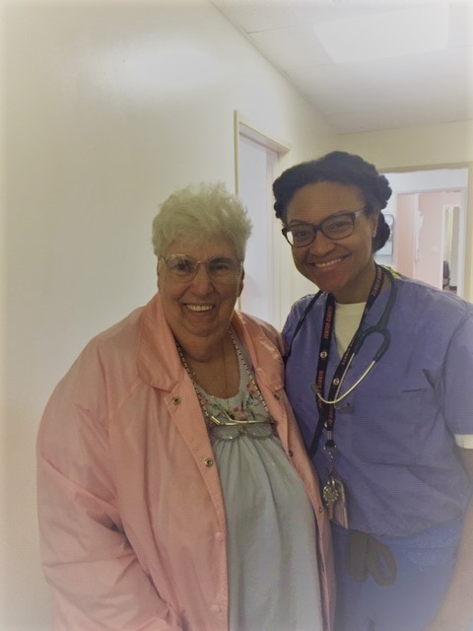
Our Patients , Our Community
Everyone has a fair and just opportunity to be as healthy as possible
Notes:
Remember that equity is not just about race.
As the Robert Wood Johnson Foundation states: Healthy Equity is achieved when EVERYONE has a fair and just opportunity to be as healthy as possible. They continue by saying that this requires removing obstacles to health such as poverty, discrimination, and their consequences, including powerlessness and lack of access to good jobs with fair pay, quality education and housing, safe environments, and health care. In essence, the equitable health of our patients in the Granite state spans across SES, rural vs urban, housing, age etc. The common denominator is us… their doctors.
I would like to hand off the next part of our discussion to Dr. Trinidad Tellez, who will focus on what we can do to address and improve health equity.

Slide 27
THANK YOU

